Slide 1


UNITE 2023
Programming Basics
Speaker
Joshua Lunn

Slide 2
Variables
Data Type | Declaration | Range (Arduino)
int | int a = -20; | -32768 to 32767
unsigned int | unsigned int a = 1; | 0 to 4,294,967,295
char | char a = 0; | -128 to 127
unsigned char | unsigned char a = 0; | 0 to 255
float | float a = 3.14; | -3.4028^38 to 3.4028^38

Slide 3
Comparison Operators
Operator | Example
== | (A==B)
!= | (A!=B)
< | (A < B)
> | (A > B)
<= | (A <= B)
>= | (A >= B)

Slide 4
Boolean
Operators
Name | Operator | Example
and | && | (A && B)
or | || | (A || B)
not | ! | !(A && B)

Slide 5
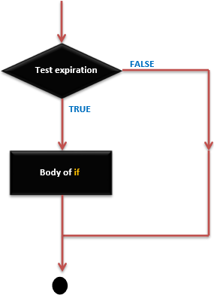
Control - if
if (expression) {
Block of statements;
}

Slide 6
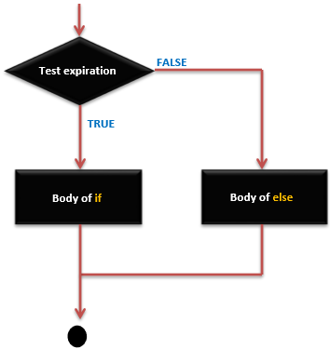
Control if-else
if (expression) {
Block of statements;
}
else {
Block of statements;
}

Slide 7
Functions
int sum_func (int x, int y) // function declaration {
int z = 0;
z = x+y ;
return z; // return the value
}

Slide 8
Arduino
Void setup() - runs once on startup
Void loop() - runs multiple times continuously

Slide 9
Thank You!
josh@thedaringwolf.com

